Slide 1
Use of Multiple Ontologies to Characterise the Bioactivity of Small Molecules
WoMBO @ ICBO, Buffalo, July 2011
Ying Yan¹
Janna Hastings^{2,3}
Jee-Hyub Kim¹
Stefan Schulz⁴
Christoph Steinbeck²
Dietrich Rebholz-Schuhmann¹
¹ Text Mining, European Bioinformatics Institute, UK
² Chemoinformatics and Metabolism, European Bioinformatics Institute, UK
³ Swiss Centre for Affective Sciences, University of Geneva, Switzerland
⁴ Institute for Medical Informatics, Statistics and Documentation, Medical University of Graz, Austria
Notes:
30 minutes → ~25 slides @1 minute per slide.

Slide 2

Bioactivity is what small molecules do in biological systems
Small molecules bind to receptors
Biochemical pathway is altered
On a macro scale, a phenotypic effect is observed
Notes:
Bioactivity comprises the total effect which a small molecule has in a biological system. They are the active (realizable) properties. Their operation is at the molecular level of granularity and yet their effect is observed at the macro level of granularity. The observable effect is a phenotypic effect.
Bioactive molecules can have positive eects, such as repressing the development
of disease, or they can have negative (toxic) eects, leading to illness or even
death. The dierentiation of bioactive molecules from non-bioactive molecules is
one of the core requirements for in silico drug discovery approaches [11], as are
delineating molecules which share similar activity proles [9]

Slide 3
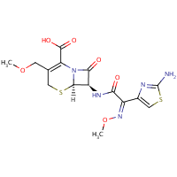
ChEBI is an ontology of small molecules and their properties
ChEBI Ontology
chemical entity
role
chemical substance
biological role
molecular entity
application
group
chemical role
carbonyl compound
pharmaceutical
solvent
carboxy group
carboxylic acid
antibacterial drug
cyclooxygenase
inhibitor
has part
has role
cefpodoxime (CHEBI:606443)
Notes:
Put the usual ChEBI picture and talk around it. ChEBI is manually curated. Chemicals are given a structure-based classification and assigned with the has_role relationship to the role ontology.
Bioactivity as we have defined it loosely corresponds to the biological role branch of the ChEBI role ontology. The additional roles which do not correspond to our bioactivity definition are being ignored for the purposes of this paper.

Slide 4
ChEBI role assertions are sparse
Chemical entities
(26000)
Chemical entities mapped to roles
(3000)
Roles
Mapped roles
(600)
has role
Notes:
Just less than 3000 chemical entities are mapped to just less than 500 roles – many chemical entities are thus not adequately described in terms of their biological context.
Also, ChEBI roles are not explicitly linked (through OWL intersections or OBO cross-products) to

Slide 5
Bioactivity is reported in the scientific literature
“Resveratrol inhibits cyclooxygenase-2 transcription and activity in phorbol ester-treated human mammary epithelial cells”
“Curcumin inhibits cyclooxygenase-2 transcription in bile acid-and phorbol ester-treated human gastrointestinal epithelial cells”
Notes:
Importantly, this is an example of relationship extraction from the scientific literature. We are looking for a special kind of association between a chemical and a biological entity. It is not an example of named entity recognition alone.

Slide 6
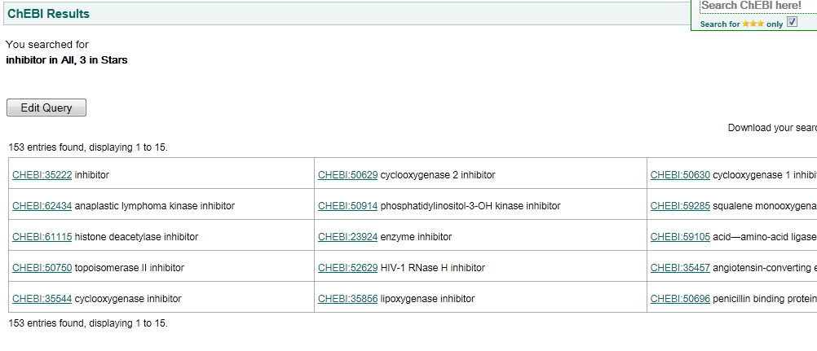
ChEBI bioactivities are pre-coordinated

Slide 7
Bioactivity refers to multiple semantic types
Enzymes / proteins in general
Biological processes
Cellular or anatomical locations
Organism type
Notes:
We wanted to classify bioactivity terms by which semantic type they belonged to. This led to challenges in that there were many examples of nested types.
For example, to formalise a description of
enzymatic inhibitor activity requires reference to the enzyme which is being inhibited;
to formalise participation in a in a particular biological process requires
reference to the process; and bioactivity descriptions may require reference to
the exact location of the activity and the organism within which, or against
which, the activity took place.

Slide 8
The language of bioactivity
inhibitor activator modulator
agonist antagonist regulator
suppressor adaptor stimulator
toxin factor messenger blocker
chemical
target
Relation extraction via trigger words as features
Notes:
We first dened a language model for bioactivity terminology based on the examination
of relevant portions of the Metathesaurus of the Unied Medical Language
System (UMLS) [1] and the ChEBI biological roles. given a set of language features: \inhibitor" and \activator", \modulator",
\agonist" and \antagonist", \toxin", \regulator", \suppressor", \adaptor",
\stimulator", \factor", \messenger" and \blocker"; these will be called trigger
words.

Slide 9
Targets and types of interaction
type of
interaction
target
beta-adrenergic receptor inhibitor
Notes:
Ideally, the phrase composing (<modier>) is constituted by one or more
tokens which denote the target of the bioactivity, whereas the head word species
the nature of the interaction between the small molecule and the target. For
example, `beta-adrenergic receptor inhibitor' has as modier `beta-adrenergic
receptor' (the target) and as head word `inhibitor' (the nature of the interaction
is inhibition).

Slide 10
Several syntactical structures
Noun phrase or adjective/adverb composition:
Kinase suppressor, HIV transcriptase inhibitor
Prepositional phrase modifier:
Suppressor of fused protein Oct-1 CoActivator in S phase protein
Verb phrase as noun phrase modifier:
Carbonic-anhydrase inhibitors causing adverse effects in therapeutic use
Relative clauses as modifier:
Factor that binds to inducer of short transcripts protein 1

Slide 11
Text mining approach
Syntactic parsing
Chemical tagging (Oscar, Jochem)
Named entity recognition
(UniProtKB, Organ, Organisms and GO Biological Process)
Target disambiguation (nested types)
Pruning ‘noisy’ results using rules
source: MEDLINE abstracts
Notes:
In Step 4, when we encountered nested types: We retain the tag which is in the last position
within the modifier, ignoring other tags.

Slide 12
Pruning out noise
Largest challenges:
Difficulty in small molecule term recognition
Small molecule – protein disambiguation
Remove triples from the candidate list when the putative small molecule term:
is a role term according to ChEBI
(e.g. antibiotic)
has the suffix -ase (normally enzyme names)
has less than three characters
Notes:
The largest challenges faced from a practical side on the named entity recognition

Slide 13
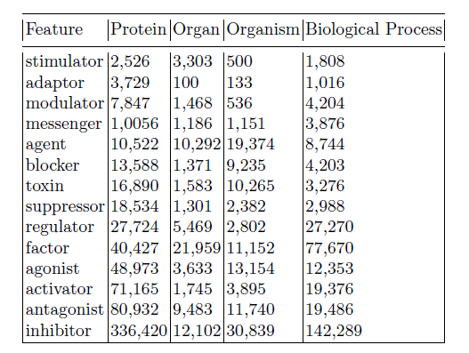
Results: distribution (feature/target)
Notes:
Table 1: ordering by target type and feature
Most common: proteins

Slide 14
Organ and Organism:
Target vs. Location
Organ and organism often provide contextual/ locational information
However there are some true positives
(as bioactivity targets)
Caesium ion antagonism to chlorpromazine- and L-dopa- produced behavioural depression in mice.
bothrops jararaca inhibitor
thyroid stimulator
Notes:
Manual examination of the results revealed that organ and organism most commonly appear as locational or contextual modifiers rather than directly as targets. Disambiguating these two scenarios is not obvious.

Slide 15
Noise
On the other hand, …
Influence of peritoneal dialysis on factors affecting oxygen transport…
Without influence on WDS were: hysotigmine, atropine …
The cellulase component was not markedly inhibited by …
body part?
species?
bioactive?

Slide 16
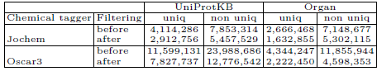
Tagging chemicals
Jochem – dictionary-based approach: better precision, lower recall
Oscar3 – machine learning approach: better recall, much more noise
Notes:
In particular we found it very difficult to get Oscar to distinguish chemical names from protein names.
Oscar3 yields many more triples than Jochem does. This is expected, since
Oscar3 recognises any chemical-like string. However, Oscar3's approach also
results in a considerable number of false positives due to its recognition of
chemical-like nomenclature appearing as a component in larger strings (such
as protein names). Furthermore, we can observe a smaller number of triples
identied by UniProtKB and Oscar3 compared to the set identied by UniProtKB
and Jochem. This is because Oscar3 produces annotations that nest within
a protein mention in the sentence and thus lowers the subsequent annotation
protein mentions. Jochem performs more long-form matching than Oscar3 does,
therefore the following protein identication has a higher likelihood of identifying
a protein term within the sentence, hence yielding a greater number of triples.

Slide 17
The ontology of bioactivity
chemical entity
has_role
bioactivity
has_target
Target
Organ
is_a
Organism
Macromolecule
Biological process
Notes:
Formal ontology of bioactivity: explicit link from bioactivity to the target of the bioactivity. We already have in ChEBI different types of bioactivity.
Based on our analysis of bioactivity phrases in the literature, we have identi
ed macromolecules and biological processes as the most common types of
targets for the bioactivity of small molecules. We could therefore introduce a
has target relationship to relate a bioactivity description to either a macromolecule
or a biological process. However, strictly speaking, the range of the
has target relationship should be restricted to those entities with which the
chemical entity can physically interact { macromolecules. We can assume that
biological processes are mentioned where the exact macromolecular target is
unknown. In the same way, anatomical or subcellular locations may be mentioned
when the exact target is unknown.

Slide 18
Macromolecules
m1 is a beta adrenergic receptor:
m1 subclassOf bearer of some
(realized by only
(Inhibition and
(has target some BetaAdrenergicReceptor)))

Slide 19
Biological processes
m2 is a mitosis stimulator:
m2 subclassOf bearer of some
(realized by only
(Stimulation and
(has target some
(participant of some Mitosis))))
Notes:
Still something missing in this, which is the implicit claim that the mitosis process itself is “stimulated”, i.e. probably either enabled or made faster, by the presence of the molecule in question

Slide 20
Organ as target
m3 is a thyroid stimulator:
m3 subclassOf bearer of some
(realized by only
(Stimulation and
(has target some
(has locus some ThyroidGland))))

Slide 21
Species as definitional constraint
m4 is a mouse thyroid stimulator:
m4 subclassOf bearer of some
(realized by only
(Stimulation and
(has target some
(has locus some (ThyroidGland and part of some Mouse)))))

Slide 22
Contextual vs. Definitional
Organisms, organs and body parts appear frequently as
contextual, locational modifiers for bioactivities
In these cases, the above formalism is too strict
We therefore introduce an additional relationship:
has context
between a bioactivity and an organism, organ, body part
Non-definitional:
the bioactivity can take place in many organisms, but was discovered through investigations in one organism.

Slide 23
Relating context to chemical-bioactivity associations
Context applies not to bioactivity alone
but to small molecule – bioactivity associations
(i.e. a ternary relationship)

Slide 24
Next-generation curation tools
Text mining support for human curation knowledge discovery effort
Multiple ontology-based reasoning for automated consistency checking and error detection
Notes:
Importantly, we are not proposing to pre-populate ChEBI from text-mining results. There is far too much noise in the data for that to work out. Rather, we are proposing the development of enhanced curation tools which support the work of the human curators.

Slide 25
Conclusions
Language model for extracting small molecule bioactivity information from text
Ontology model for accurately representing such information, and allowing automated reasoning across ontologies from chemicals to their targets

Slide 26
Future work
Gold standard for chemical bioactivity in text to be used to evaluate our approach and to train machine learning tools
Extending the relationship extraction approach to include chemical roles, applications and structural relationships

Slide 27


Acknowledgements
Thanks
Colin Batchelor (RSC), Adam Bernard (EBI)
Funding
BBSRC, grant agreement number
BB/G022747/1 within the
"Bioinformatics and biological resources" fund

