Slide 1
Wm L (Bill) Crosby Department of Biological Sciences University of Windsor
From Protein Complex to Supra-Complex A case study in RING-Class E3-Ub Ligases

Slide 2
Talk Outline
Re-visit protein complex/supra-complex representation – a view from the ‘Domain trenches’
Example of SCF/RING E3-Ub Ligases
General Structure and Function
E3-Ub Ligases in different model systems
E3-Ub Ligases as a model for complex/supra-complex ontology development
Current state of SCF/RING ontology
Future directions

Slide 3
E3-Ub Ligases
Effect the post-translational ubiquitination of ‘target’ proteins
Ubiquitination:
Transfer of single or polymers of 76 aa peptide Ubiquitin to ‘target protein’ = ‘signalling ‘conjugate
Mon-ubiquitination may involve
Modification of protein compartmentation
Modification of protein activity (structural or enzymatic)
Multiple ubiquitination (via Lys-48) commonly signals destruction via the 26S proteasome
Subject to activity of de-ubiquitination enzymes (DUBs) as an additional level of regulation

Slide 4
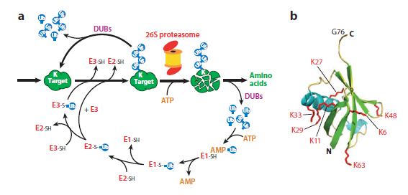
The Ubiquitin Proteolysis System
Hua and Virstra (2011) Ann Rev Plant Biol

Slide 5
SCF/RING Class of 3-Ub Ligases
Most common class of E3-Ub ligases in metazoans
Minimally comprised of 4 canonical subunits
Cullin protein
S-kinase specific protein 1 (Skp1-like protein)
Ring H2 Finger Protein
Subunit recognition subunit (commonly F-Box domain-containing) protein
Constitute 1 class (of 5) of CRLs

Slide 6
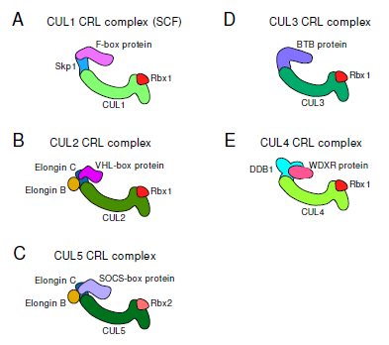
Multiple Classes of Cullin RING Ligases (CRLs)
Bosu and Kipreos (2008) Cell Division

Slide 7
Gene Family Complexity Encoding SCF/RING Subunits
Organism | FBX Genes | Skp1-like Genes
S. cerevisiae | 20 | 1
C. elegans | 520 | 13
D. melanogaster | 27 | 8
H. sapiens | 69 | 1
A. thaliana | 700 | 21

Slide 8
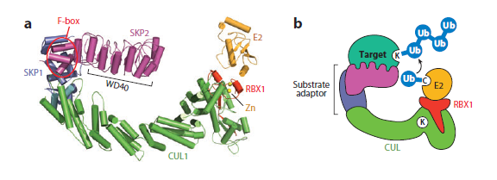
Structure of Cullin/RING Complex
Zheng, A. et al (2002) Nature

Slide 9
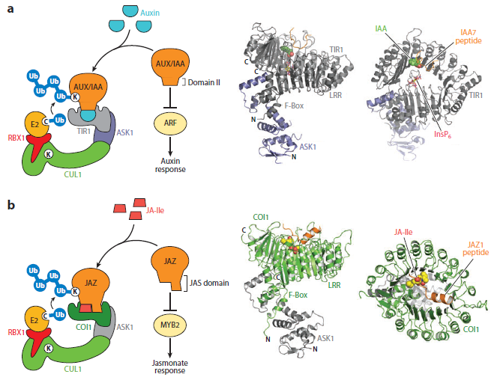
Plant Examples: SCF^{TIR1} and SCF^{COI1}
Hua and Virstra (2011) Ann Rev Plant Biol

Slide 10
SCF/RING Quaternary Structure
Increasing evidence of subunit stoichiometry of >1 for select CRLs
Recent evidence of supra-CRL complex formation essential for function
Examples
FBX4p; regulated telomere maintenance protein (PIN2/TRF1) via an SCF complex in yeast
CDC4p; regulation of mitotic check-stop proteins (Sic1)
TIR1; regulation of Auxin perception in plants via SCF^{TIR1}
Thus, supra-molecular complexes likely regulate complex cellular processes

Slide 11
Supra-molecular structure of Cdc53:CDC4p CRL Complex in Yeast
Tang et al (2007) Cell

Slide 12
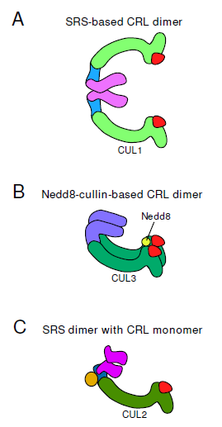
Evidence for Function-Associated Altered Stoichiometry of CRL Subunits
PTM-dependent supra-complex formation
Substrate-driven altered stoichiometry?

Slide 13
CRLs - a Model for Protein Complex Ontology Development
CRLs offer full spectrum of complex and supra-complex structure/function complexity
Regulatory dimensions include:
Combinatorial complexity of complex formation across spatio-temporal domains
PTM of both complex and target substrates that alter quaternary structure
Compartmentation (e.g. COP9 signalasome; TIR1p)
Subunit stoichiometry (may be variable and dynamic)
Supra-molecular complex formation
Non-human model organisms present significant genetic and structural complexity – an opportunity

Slide 14
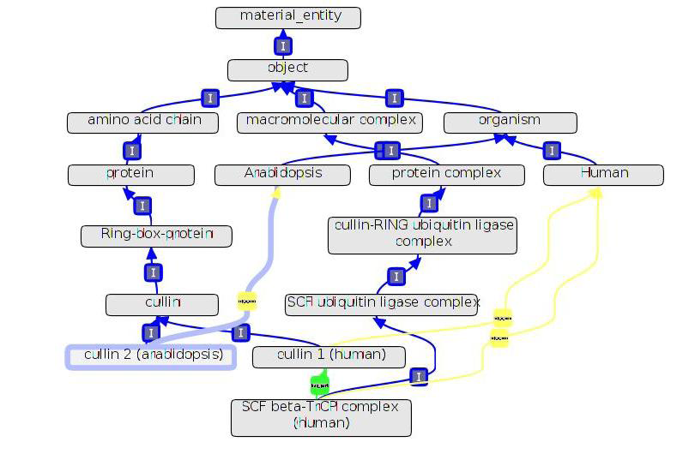
Current State of the Ontology

Slide 15
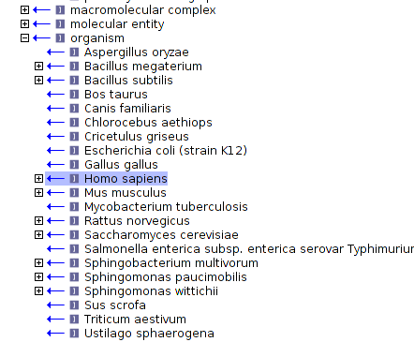
Future Steps
Include an expanded model organism information set to inform ontology development
Expand class definitions and relationships within current ontology to include multiple attributes
PTM (NEDD, RUB, CANDI-complex)
Compartmentation
Subunit Content
Supra-molecular complex formation
Both continuant and recurrent classes for complex gene families (ASK)
Link to functional Dbases for specific complex instantiations

Slide 16
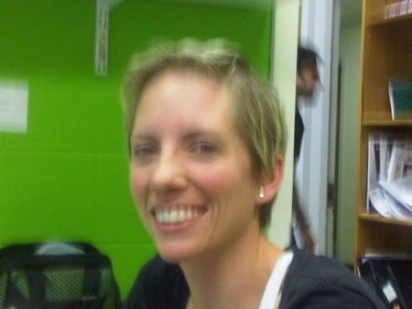
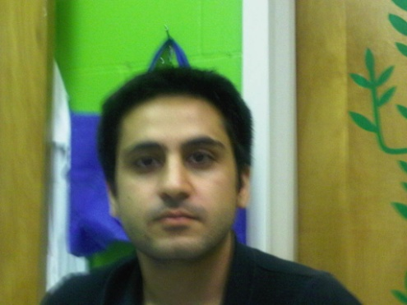
Acknowledgments
C. Wu (UDel)
D. Natale (GWU)
Claudia Dinatale
M. Dezfulian

Slide 17
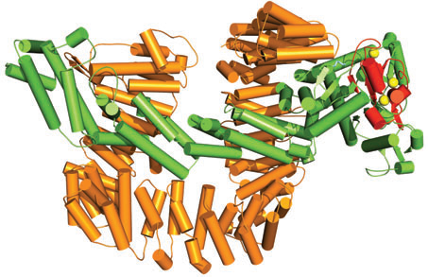
Quaternary Content Alters Functional State of CRLs
Hua and Virstra (2011) Ann Rev Plant Biol

